Slide 1
CDS-M
Technical data layer

Slide 2
5 Levels
City-TO agreement
Use cases
Specification
Building blocks
City / TO specification

Slide 3
Level 1
Specification
Object model, specified in OpenAPI
optionally endpoints for listing standard building blocks/use cases

Slide 4
Level 2
Building blocks
Contract
DPIA
Certificates
Sharing
Standards
Storage
…
ISO 27001
…
None
Open data
…
NeTEx
GBFS
GTFS
TOMP-API
…
Limit time
encryption
Encryption
Secure channel
…
Blockchain
Data transport
Terms & Conditions
BIO
…
Authentication
None
Basic
PKI
Whitelisting
…
Aggregation
time
location

Slide 5
Level 3
Use cases
To be defined, expressed in accepted building blocks

Slide 6
Level 4
City / TO specification
City selects use cases that they need
Use case =>
building blocks =>
range of standards/techniques, contracts, terms and conditions that are applicable
TOs can select the building blocks they can fulfill
Summarized and clear for mobility providers to find out if they can apply

Slide 7
Level 5
City-TO agreement
Cities and TOs can find out (automatically) the overlap between the demand and supply on each side
Can be part of the contract between city and TO, solidifiable and testable/quantifiable

Slide 8
CDS-M
Validation

Slide 9
Building block - detail
To each agreed building block, we can add consequences. These can be related to ethical, security or interoperability dimensions.
If a city or TO selects a use case, containing a building block with consequences, we can quantify their choices.
To quantify, we need standards on these dimensions
Privacy: Tada
Security: OWASP (selection)?
Interoperability: Maturity Model for Enterprise Interoperability (MMEI)
For instance, if they choose to allow GBFS with non-rotating asset IDs, the ethical dimension of Tada ‘tailored to the people’ is harmed.

Slide 10
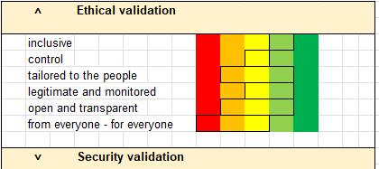
Summarized
The City or TO specification AND the City-TO agreement can be aggregated, the consequences can be added up, and a range (in case of city or TO specification) or a specific value can be derived.
For example: a city selects X use cases, containing building blocks with consequences, and the summarized penalties per dimension can be displayed in a tool. This way, cities and TOs can directly see the impact of their choices

